Slide 1

Log Analyzer based on LogLLM for
VS Code
Members:
Zhihong Zhang, Yu Fu
Simin Xian, Wenhao Li
Jiajun Zhang, Shuang Leng
Group: Git Commit
Date：2025/12/10
Notes:
Good morning, everyone! We are GitCommit Group 8. Today, we will share you a VS Code Plugin for log anomaly detection based on LogLLM.

Slide 2


01
Project Background and Objectives
Content
02
Core Technical Solution
03
Agile Development Process
04
Testing and Experimental Results

Slide 3

01
Project Background and Objectives

Slide 4
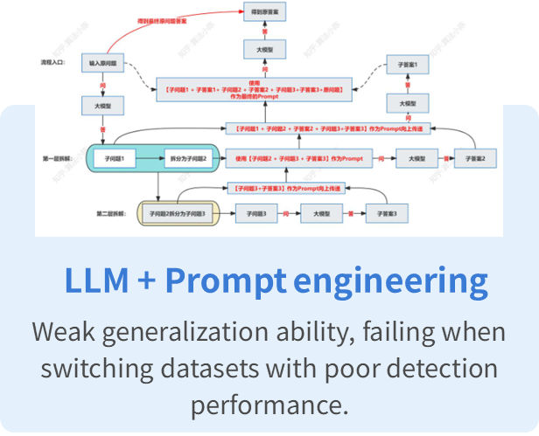
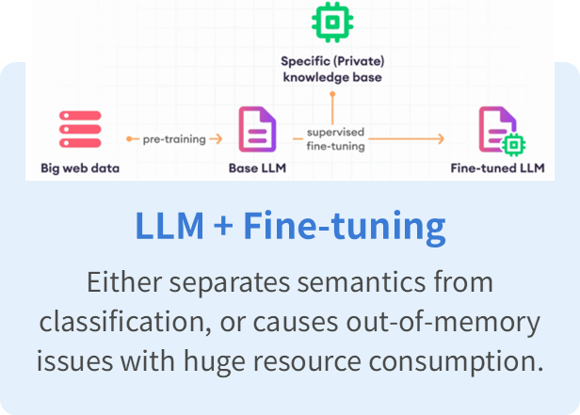
01-Academic Evolution and Bottlenecks in Log AnomalyDetection
The Importance of Logs
System logs serve as the core observational medium for software reliability research, documenting runtimedocumenting runtime states and events to provide critical information for debugging, performanceperformance monitoring, and reliability assurance.
Limitations of Existing Methods
Current log anomaly detection methods face a triple dilemma: cloud-based large models compromise privacycontrol, IDEs lack unified analysis interfaces, and traditional tools struggle with complex logs,making itdifficuttobalanceparsingaccuracanefficnc.
Research Objectives
This research proposes a localized large-model solution based on LogLLM, meeting three stringent criteria:stringent criteria: high parsing performance, zero privacy leakage, and native IDE integration. It establishes aIt establishes a new engineering paradigm for log anomaly detection.
Notes:
Current log anomaly detection methods face a triple dilemma: privacy leakage, lack of a unified analysis interface in IDEs, and low parsing efficiency. Our research will propose a localized solution based on LogLLM to achieve high performance, zero privacy leakage, and native IDE integration.

Slide 5
02
Core Technical Solution

Slide 6
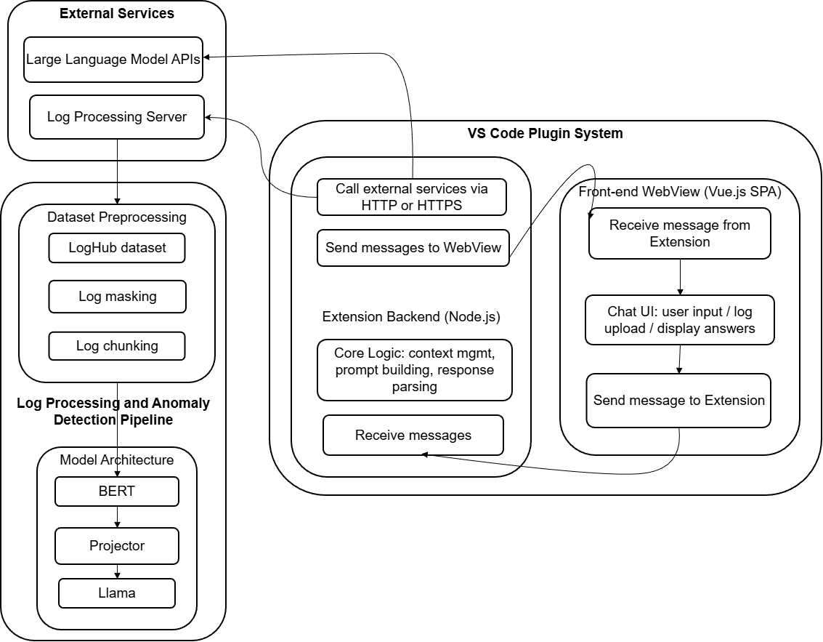
02- System Architecture Diagram
Three Core Components:
Left-side External Services (LLM APIs, Log Processing Server)
Middle VS Code Plugin System backend
Right front-end WebView
Notes:
This figure illustrates the system architecture of the VS Code plugin for anomaly log parsing based on LogLLM, which consists of three core components: left-side External Services (LLM APIs, Log Processing Server), middle VS Code Plugin System backend (Node.js-based for core logic/communication), and right front-end WebView.

Slide 7
02- Front-end Framework
Front
Back
The plugin's frontend is a Vue.js single-page application embedd-ed in the VS Code WebView, sending and receiving messages via post Message, and updating the UI through Pinia to achieve real-time interaction.
The plugin's backend runs in the Node.js environment provided by VS Code, monitors frontend messages, processes core business logic, returns results via encapsulated interfaces, and ensures the security of sensitive information.
Notes:
That talk about the architecture about the front-end. In this project, we choose WebView and Node.js as our main technologies, because VS code itself is also a editor based on this two technologies, this bring certain convenience. Because we can use the original vscode api to construct our process communication without the third libraries. In the front-end architecture design, we have two main part, first is the user interface based on the Vue.js framework, then we use the webview technology to render it on the VS Code page, and we use Node.js to communicate with the whole web page and external interface.

Slide 8
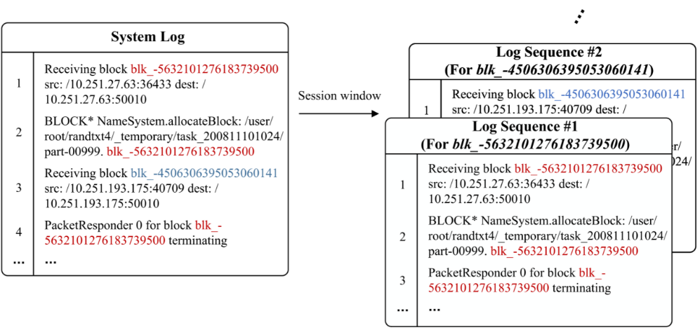
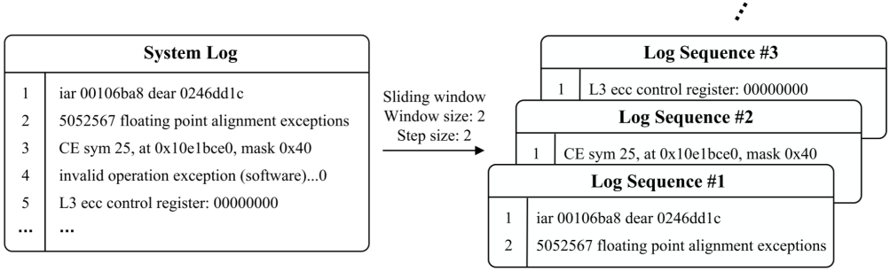
02- Log Preprocessing
LogHub
Slicing Strategy
Dataset | Description | Type | Size
HDFS | Hadoop distributed file system log | Distributed system | 1.47GB
BGL | Blue Gene/L supercomputer log | Super computer | 708.76MB
Thunderbird | Thunderbird supercomputer log | Super computer | 29.60GB
Linux | Linux system log | Opreating system | 2.25MB
Apache | Web server error log | Server application | 4.90MB
Regular Expression De-sensitization
Pattern: IP address: '\d{1,3}\.\d{1,3}\.\d{1,3}\.\d{1,3}(:\d{1,5})?', MAC address: '([0-9A-Fa-f]{2}:){11}[0-9A-Fa-f]{2}', File Path: '[a-zA-Z0-9]*[:\.]*([/\\]+[^/\\\s\[\]]+)+[/\\]*' Before: 2354412 floating point alignment exceptions ;-; 2354412 floating point alignment exceptions iar 001061e8 dear 0247015c ;-; iar 00106200 dear 0247016c ;-; iar 001061b4 dear 024701dc ciod: Received signal 15, code=0, errno=0, address=0x000001f2 10668 total interrupts. 0 critical input interrupts. 0 microseconds total spent on critical input interrupts After: <*> floating point alignment exceptions ;-; <*> floating point alignment exceptions ;-; <*> floating point alignment exceptions iar <*> dear <*> ;-; iar <*> dear <*> ;-; iar <*> dear <*> ;-; iar <*> dear <*> ;-; iar <*> dear <*> ciod: Received signal <*>, code=<*>, errno=<*>, address=<*> <*> total interrupts. <*> critical input interrupts. <*> microseconds total spent on critical input interrupts
Session window
01
2
Sliding window
Notes:
To collect various types of logs, we used the public dataset，LogHub, which contains records from distributed systems, super computers, operating systems and server applications.
The logs differ in size. We applied different preprocessing strategies. First, we used predefined regular expressions to filter out IP addresses, MAC addresses and timestamps that are irrelevant to anomalies; they were replaced with asterisks. This helps the model focus on semantic content and understand system behavior.
For log partitioning, on HDFS logs we used a session-window strategy that aggregates messages into sequences by block ID; for other logs we used a sliding-window protocol. Examples are shown in the figure.

Slide 9
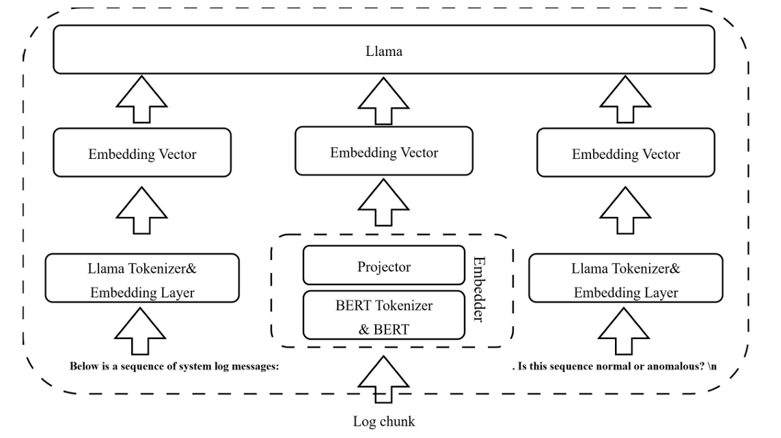
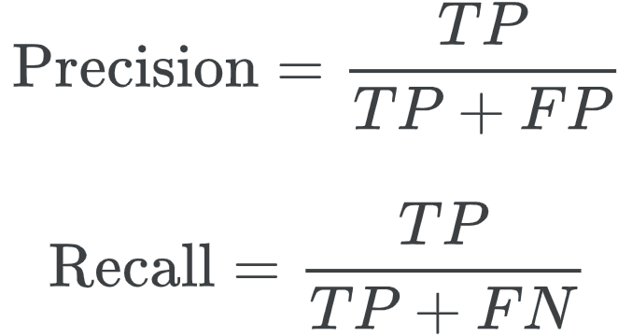
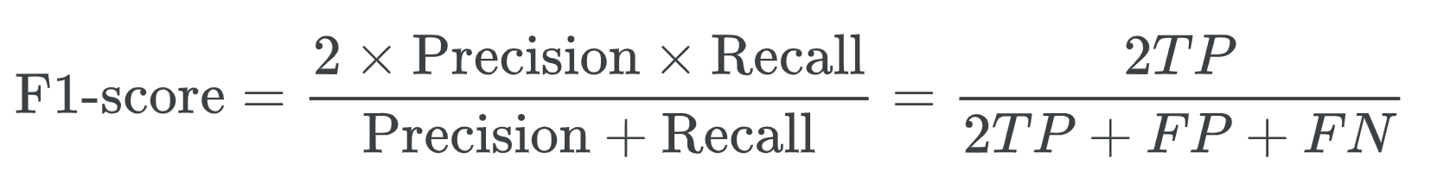
02- LogLLM Model
LogLLM Framework
Bert
The raw log messages are transformed into high-dimensional semantic vectors to capture the deeper meaning in the logs and provide a foundation for subsequent processing.
Lama
Receive a sequence of log vectors and combine it with a prompt template to perform anomaly classifi-cation.
Projector
To achieve semantic alignment, A linear mapping layer transforms the vectors output by BERT into a representation space that Llama can understand.
Evaluation Metircs
Notes:
We adopted a model architecture called LogLLM: BERT extracts dense semantic representations from single log messages, and LLaMA performs sequence-level anomaly classification. A projector aligns the vector spaces between the two modules.
We evaluate with precision, recall and F1-score for the binary classification task.

Slide 10
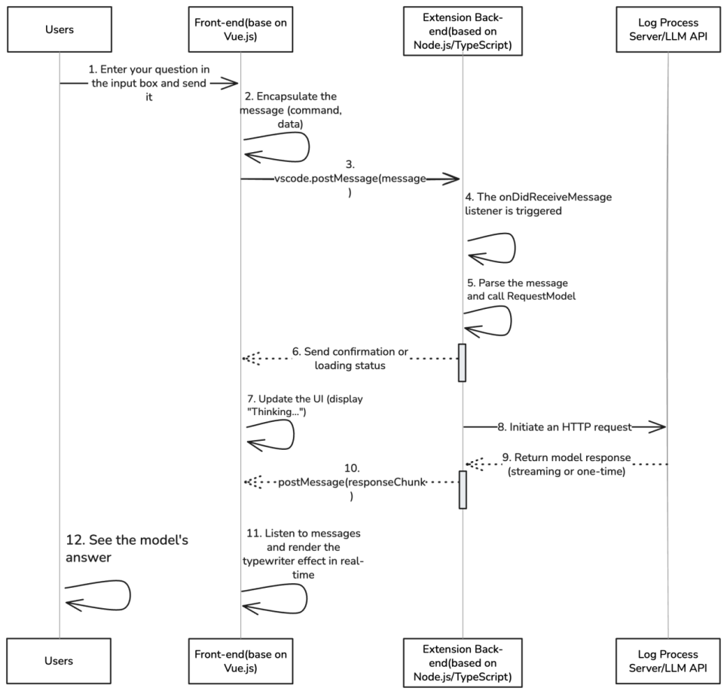
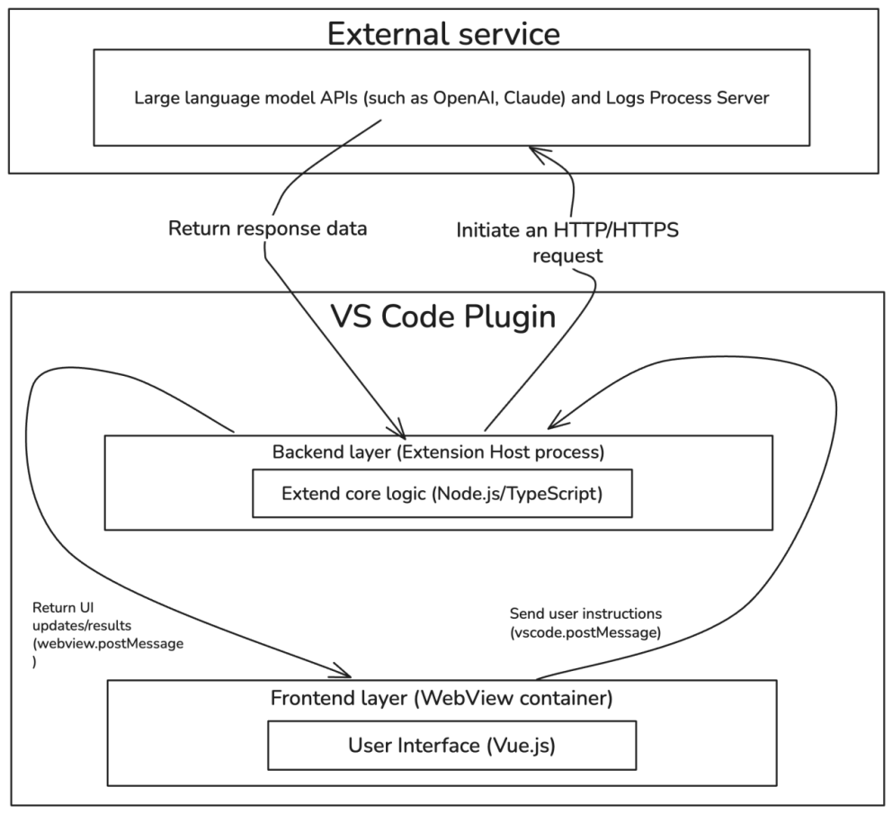
02- Front-end Implementation
Framework of Front-end
Front-end interaction

Slide 11
03
Agile Development Process

Slide 12

03 Requirement Clarification - (Sprint 1)
02
03
01
Requirement Clarification
User Stories
Specification Documentation
Conduct requirement workshops to define user stories and validate feasibility through techn
-ical research
Focus on Requirements Analysis and Architecture Design
Configure the development environment and produce the requirements specification document and system architecture diagram
Notes:
In this sprint, we focused on three key tasks: first, requirement clarification, emphasizing requirements analysis and architecture design; second, conducting workshops to define user stories and validate feasibility through technical research; and finally, configuring the development environment to produce the requirements specification document and system architecture diagram. This laid the foundation for the project.

Slide 13
03-Development with Model Integration (Sprint 2)
Frontend and Backend Development
Frontend and Backend Development, encompassing backend servicesetup and LogLLM model integration,frontend interfaceimplementation, and frontend-backend data communication integration
Model Integration and Delivery
Includes refinement of features such as custom prompts, delivering afunctional plugin prototype.
Notes:
This phase had two parts: frontend and backend development, LogLLM model integration and data communication; and model integration and delivery.

Slide 14
03- Testing Optimization and Deliverables (Sprint 3)
03
01
Deliverables
Multi-Dimensional Testing
Compiled test reports and user manuals, delivering the v1.0 plugin package.
Conduct functional, performance, security, and compatibility testing to ensure system stability and reliability.
Notes:
We finally delivered compiled test reports, user manuals, and the v1.0 plugin package.

Slide 15
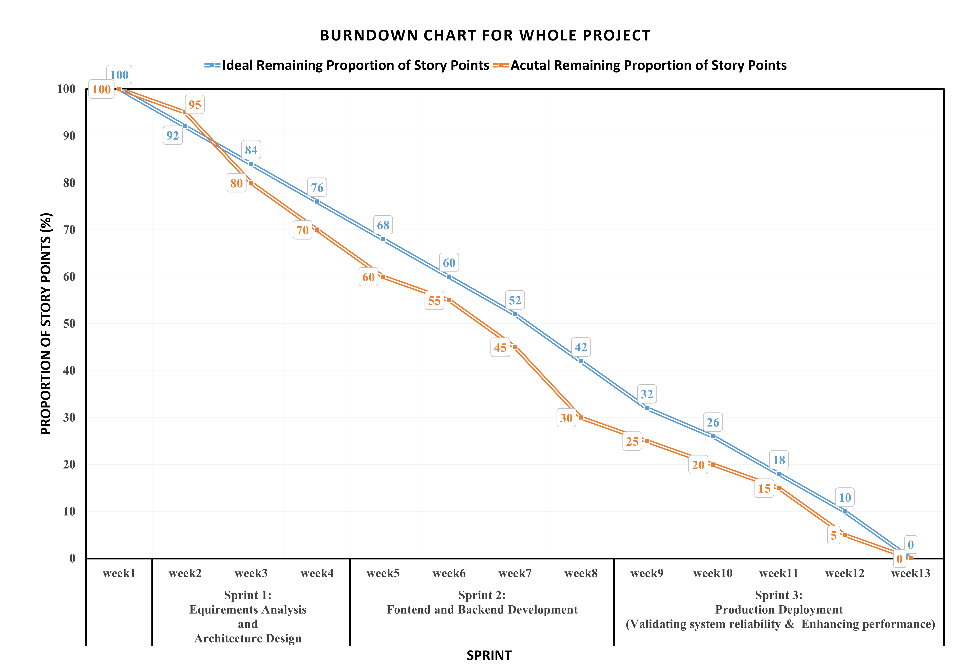

03- Burndown Chart
Burndown Chart Display
Burndown Chart Display Displaying Sprint 1-3 burndown charts, with the vertical axis representing remaining Story Points and the horizontal axis showing weeks. The curve exhibits a steady decline.
Notes:
The final one is the "Burndown Chart", displaying progress from Sprint 1 to 3. The vertical axis shows remaining story points, the horizontal axis represents weeks, and the curve declines steadily, indicating we stayed on track.

Slide 16
04
Testing and Experimental Results

Slide 17
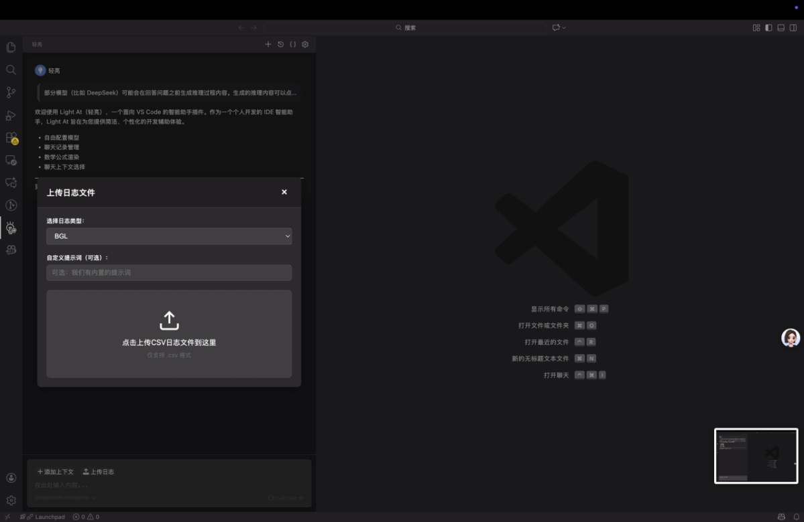
04- User Experience Flow- 1
Log File Upload
Interface
Display the log file uploadinterface, highlighting itszero-configuration setup forquick access, enabling usersto import logs rapidly.

Slide 18
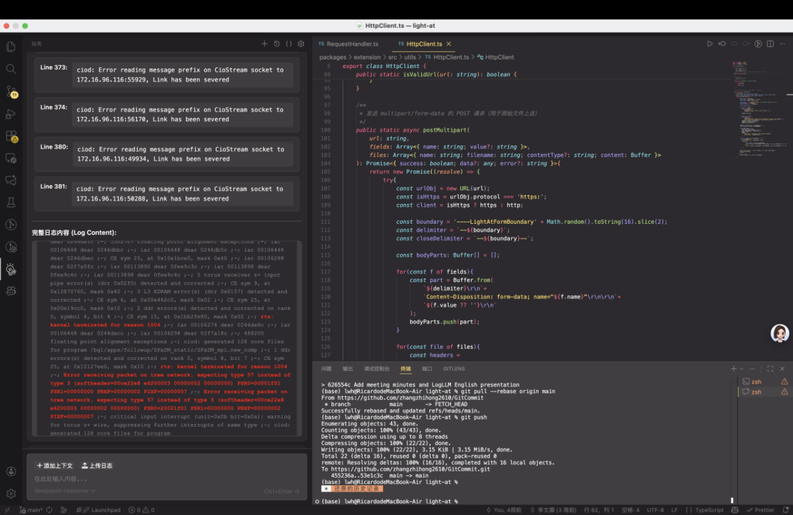
04- User Experience Flow- 2
Highlighted
Abnormal Content
Display abnormalcontent with ahighlighted effect tohelp users quicklypinpoint issues andimprovetroubleshootingefficiency.

Slide 19
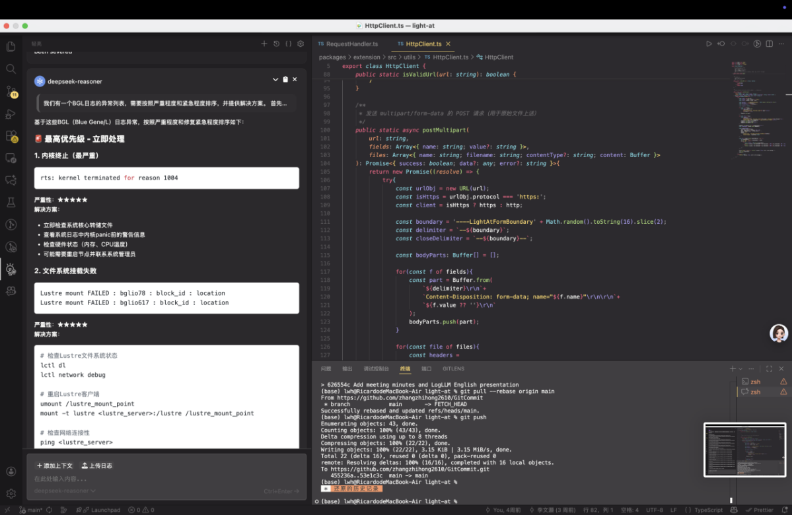
04- User Experience Flow- 3
AI Model’s
In-depth Analysis
Report on
Log Anomalies
Solutions prioritized byissue urgency. Present Al in-depthanalysisreportshighlightingtraceableconclusionstoproviderobust support for problemresolution.

Slide 20



04- Testing
Test Preparation
Test Case Execution
Defect Management
Execute test cases according to priority: P0 (Blocking) → P1 (High) → P2 (Medium) → P3 (Low), and document execution results and defects in detail.
Establish a multi-environment testing matrix, prepare test datasets and tools, and organize tester training to support end-to-end testing.
Track defects contin-uously and perform regression testing for resolved issues to ensure stability.
Notes:
We set up a **multi-environment testing matrix** , prepared data and tools, and trained testers for end-to-end testing.
Tests followed **priority order: P0 → P1 → P2 → P3** , with all results and logs recorded.
All defects were recorded in an internal tracking system, including reproduction steps, expected vs. actual behavior, screenshots or logs, and impact assessment.
We continuously tracked resolution progress and performed **regression testing** after each fix to ensure issues were fully resolved without introducing new problems.

Slide 21
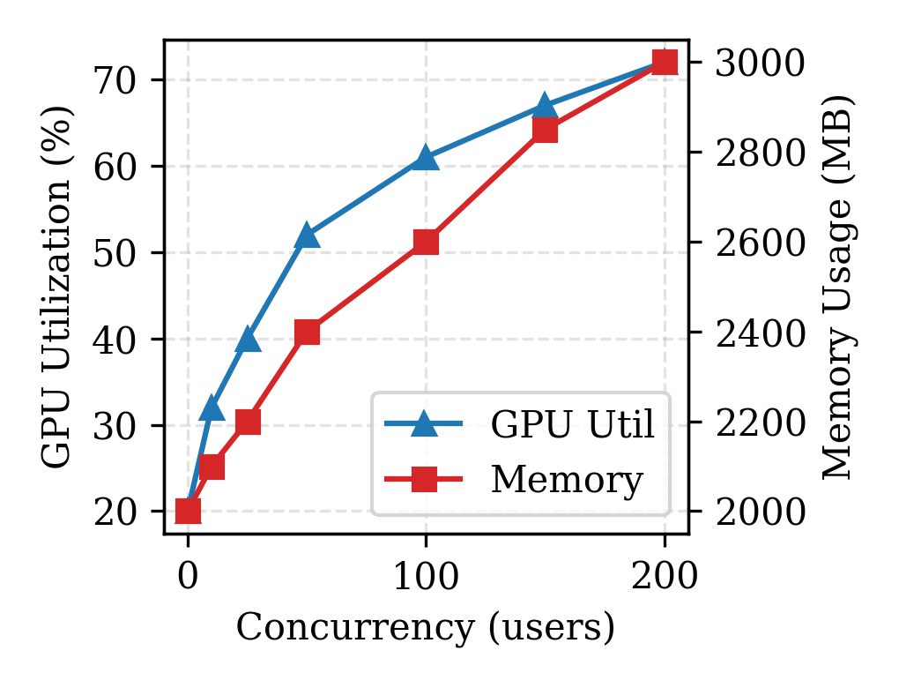
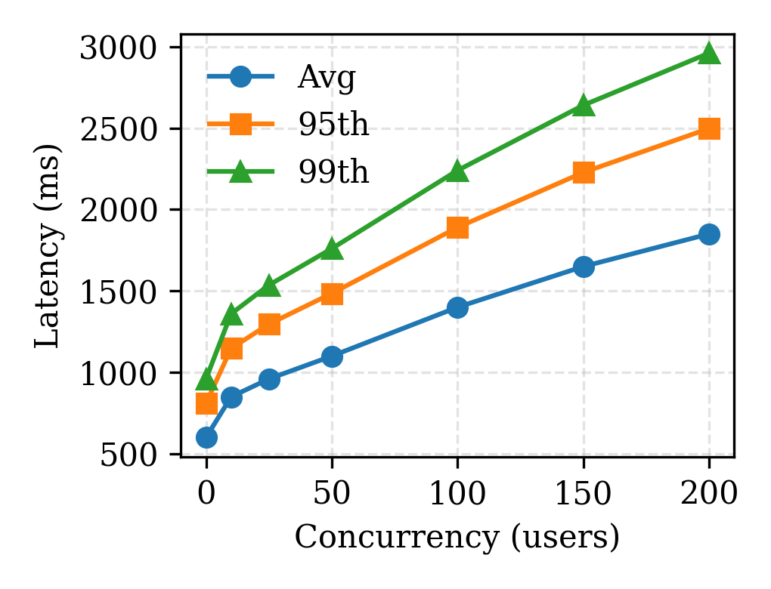
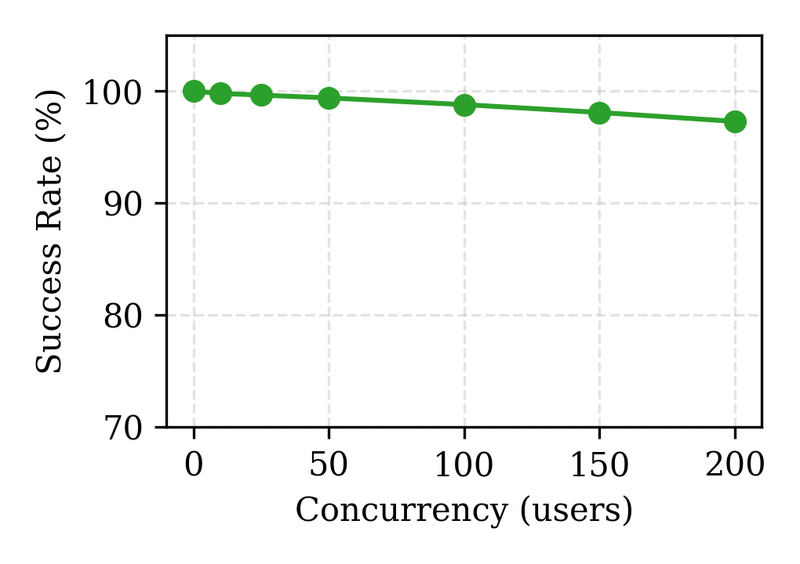
04- Testing Result
Latency Performance
Success Rate
Resource Utilization
Latency (average, 95th percentile, 99th percentile) increases with concurrency (0–200 users) but remains within acceptable limits.
Request success rate stays above 97% across all concurrency levels.
GPU utilization (>70%) and memory usage (~3000MB) grow reasonably under 200 concurrent users without resource exhaustion.
Notes:
We tested the system under 0 to 200 concurrent users.
Latency increased with concurrency but remained acceptable, **request success rate stayed above 97%** , and GPU/memory usage grew reasonably without resource exhaustion.
Overall, the system remained **stable and responsive under high load** .

Slide 22
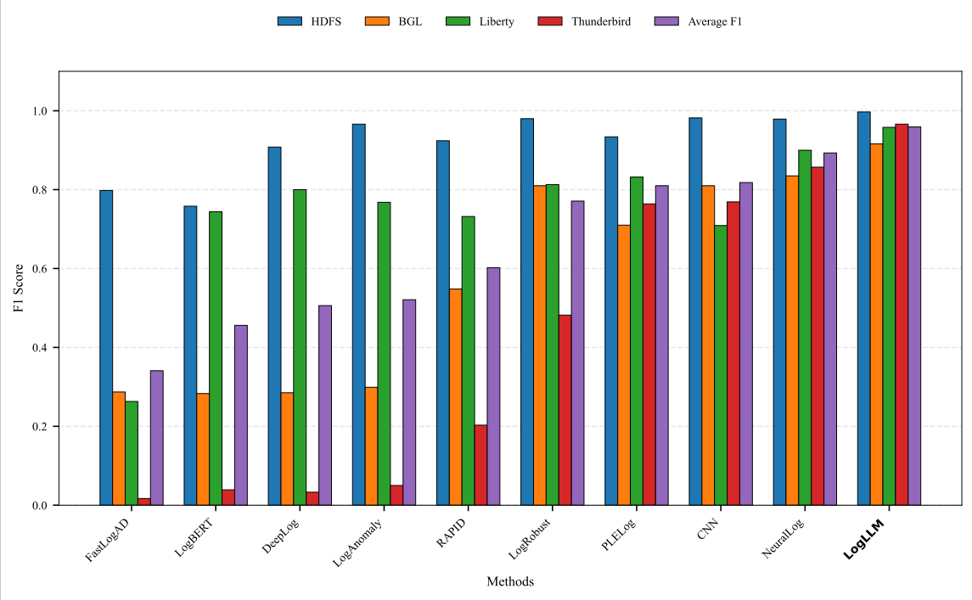
04- Testing Result: F1 Score Comparison
Comparison of F1-scores across multiple log analysis methods (e.g., FastLogD, LogLLM).
LogLLM (rightmost) achieves the highest F1-score (≈1.0), significantly outperforming other methods such as HDFS and IGL, and exceeding the average benchmark.
Notes:
Finally, the F1-score comparison chart shows the accuracy of various log anomaly detection methods such as FastLogAD and LogLLM.
From the chart, we can see that **LogLLM (rightmost bar) achieves the highest F1 score, nearly 1.0**, significantly better than the other methods.
This confirms that our model achieves **state-of-the-art accuracy** in log anomaly detection.

Slide 23

THANKS
Goup: GitCommit
Date：2025/12/10

